Slide 1
Deep Learning in Strain Gradient Elasticity
Deep bansal – 2020me10927
HarshVardhan Singh – 2020me10934
VANSIHKA Chauhan – 2020ME10980
Aaryan Ahuja- 2020me10898
Parth jaiswal – 2020me10959
MENTORS
Rajnish Kumar , Sujash Bhattacharya

Slide 2
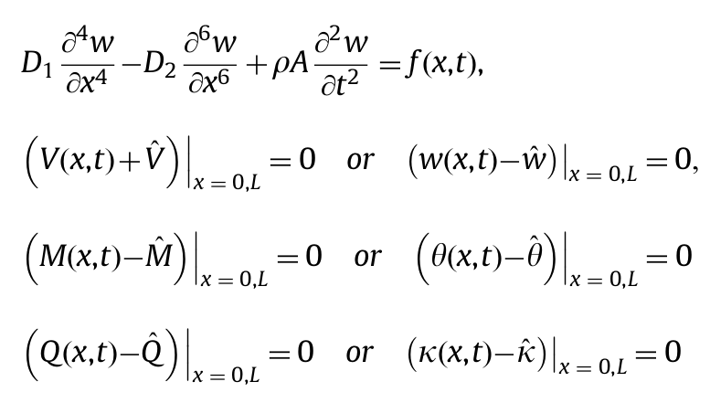
AIM: To develop a PINN solver for Euler Bernoulli Beam
To Solve
w = displacement of beam under applied load
f(x,t) = distributed lateral load exerted
to the beam
V (x,t) = resultant transverse force acting on the beam
sections, work conjugate to w
M(x,t) = the resultant moment on a section caused by
the classical and non-classical stress components
Q(x,t) = higher-order resultant on a section caused by higher-order stresses, work conjugate to k
w , θ and κ stand for the possible prescribed deflection, slope and curvature of the beam at the end sections respectively.

Slide 3
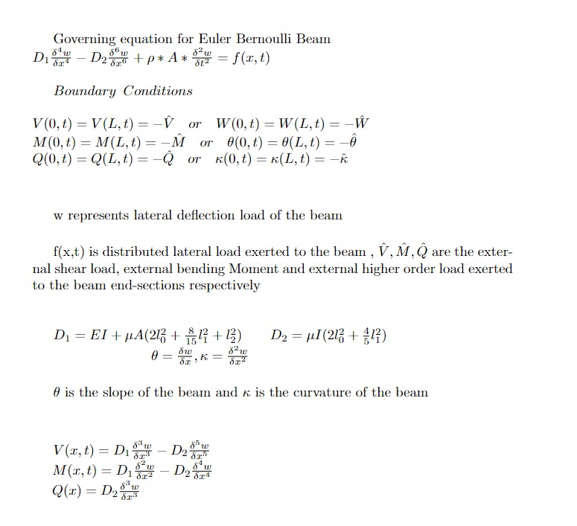

Slide 4
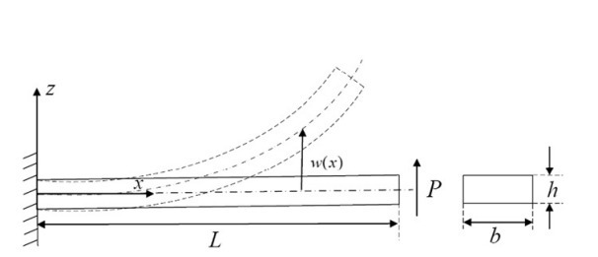
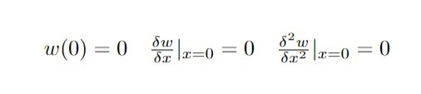

Cantilever Beam- Boundary Conditions
P is the point load exerted at free end of the beam

Slide 5
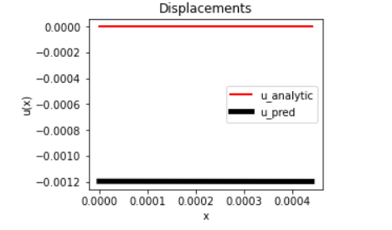
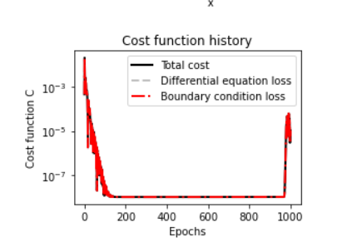
Approach(s) to the Problem
We have applied the governing differential equation and the boundary conditions for static model for Euler Bernoulli.
We have applied different Activation functions like Tanh, Sigmoid, ReLU.
We applied different Py-torch optimizers like Adam, LBFGS, Adadelta and SGD.
Result- Differential equation loss was not changing. On careful observation, we assign this to the problem of vanishing gradients. The derivatives of “u” wrt “x” of order bigger than 1 were 0.

Slide 6
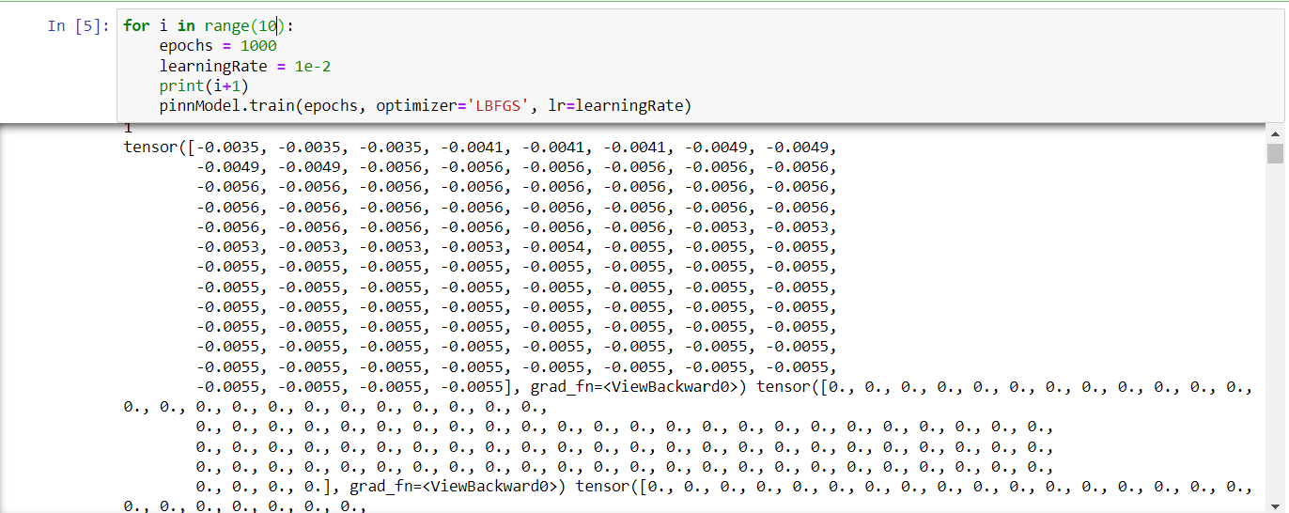

Slide 7
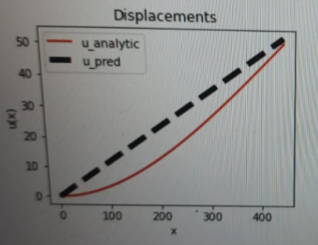
Approach(s) to the Problem
We scaled up the values of Differential eqn and boundary condition losses, but the gradients were still zero.
In next step, we changed the scaling from meters to micro-meters and nano-meters for all the values but the problem did not change

Slide 8
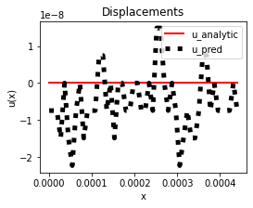
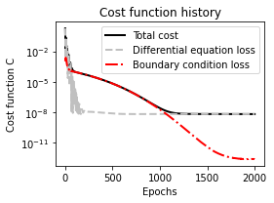
Approach(s) to the Problem
Next we non-dimensionalized all the equations to resolve ambiguity in dimensions.
Results- The values of u and v came in range
0-1. The differential equation losses were decreasing with epochs and we got the following graph-

Slide 9
CONCLUSION
Activation functions like ReLU and sigmoid give the problem of vanishing gradients, hence for our problem, Tanh is a better-suited function.
In all our approaches, the closest graph to deflection was given on scaling the parameters but the graph was not consistent. Consistency, although irregular in nature is shown in case of non-dimensionalization.
We also tried differentiating variable terms rather than forming gradient tensors using Sympy library but it did not work because it leads to logistic regression in different layers but the result was incorrect and the time of execution was very high.

Slide 10
REFERENCES
Kahrobaiyan, M. H., M. Asghari, and M. T. Ahmadian. "Strain gradient beam element." Finite Elements in Analysis and Design 68 (2013): 63-75.
Jafari, Akbar, and Meysam Ezzati. "Investigating the non-classical boundary conditions relevant to strain gradient theories." Physica E: Low-dimensional Systems and Nanostructures 86 (2017): 88-102.
Akgöz, Bekir, and Ömer Civalek. "Analysis of micro-sized beams for various boundary conditions based on the strain gradient elasticity theory." Archive of Applied Mechanics 82.3 (2012): 423-443.
Zhao, Junfeng, et al. "Nonlinear microbeam model based on strain gradient theory." Applied Mathematical Modelling 36.6 (2012): 2674-2686.
Moheimani, Reza, and Hamid Dalir. "Static and dynamic solutions of functionally graded micro/nanobeams under external loads using non-local theory." Vibration 3.2 (2020): 51-69.

